Slide 1





Clone-Based Variability Management in the Android Ecosystem
John Businge Mbarara University of Science and Technology, Uganda | Moses Openja Mbarara University of Science and Technology, Uganda | Sarah Nadi University of Alberta, Canada | Engineer Bainomugisha Makerere University, Uganda | Thorsten Berger Chalmers | University of Gothenburg, Sweden

Slide 2
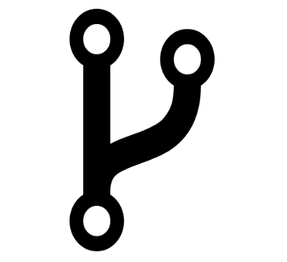
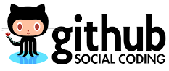









Mobile-app variants
Software Reuse
Reasons for creating App Variants:
Different user needs
Different markets
Different payment modes
Different hardware
Fork-based development
>700K android repos on Github
>2K android repos forked >1000 times
Open Source Apps
Commercial Apps
Bitcoin wallet App variants
Angry Birds App variants
Variant 2
Variant 4
Variant 2
Variant 4
Variant 1
Mainline
Variant 1
Variant 3
Variant 3
Notes:
The advent of social coding websites like Github and bitbucket have made large scale software reuse more systematic through practices like Fork-based development
Some software that have heavily benefited from this practice are Mobile Apps
Examples of Mobile Apps with may variants that we studied include Bitcoin wallet

Slide 3
Mobile App Variability Management
Variability management methods should be employed to effectively develop variants
Substantial software reuse in the android ecosystem is through cloning [1,2]
Simple variability management like clone&own to develop and maintain the app variants.
Unknown practices employed; hindering improvement of the development practices.
J. Mojica, B. Adams, M. Nagappan, S. Dienst, T. Berger, and A. E. Hassan, “A large scale empirical study on software reuse in mobile apps,” IEEE Software , vol. 31, no. 2, pp. 78–86, Mar. 2014.
F. Sattler, A. von Rhein, T. Berger, N. S. Johansson, M. M. Hardø, and S. Apel, “Lifting inter-app data-flow analysis to large app sets,” Automated Software Engineering , no. 25, pp. 315–346, Jun 2018.

Slide 4
Goal
Understand variant management practices in the Android ecosystem
Focus
We identify app families and study app family variability management practices in depth
What is an App family?
A collection of apps on Github that are maintained together, consisting of a mainline variant and its forked variants.

Slide 5
Research Questions
RQ1 - What are the characteristics of Android app families?
RQ2 - How are app families maintained and co-evolved?
RQ3 - How diverse are the contributors in Android app families?
RQ4 - What are the various types of variations or customizations that lead to the creation of an app family?

Slide 6
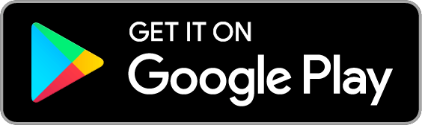
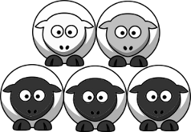

App Family Identification
Mainline Variant
Fork Variant 1
App family
Fork Variant 2
MLV
Fork Variant 3
FV1
Fork Variant 4
Fork Variant 5
FV5
App family > =2 Variants

Slide 7
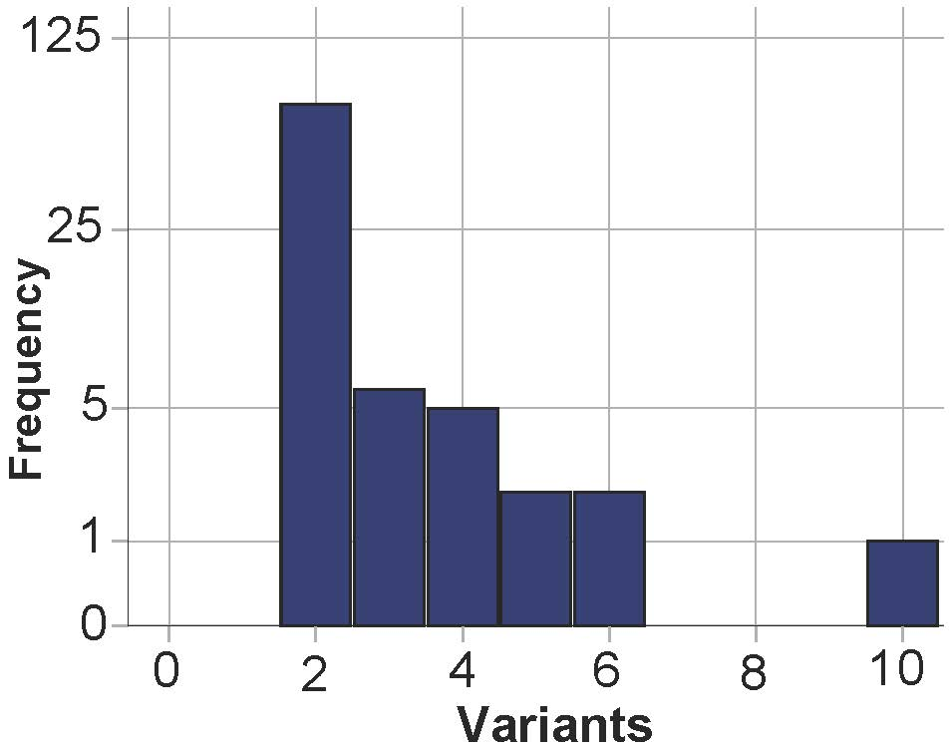
App Family Identification – Search Statistics
Number of variants per family
55,939
(Apps)
Mainline Android repos
>1 Forks
5,535
Mainline repo is advertised on Google Play (GP)
88
RQ1 – Characteristics of Android app families – Results
Few app families found hosted both on Github and Google Play
These have rather few variants
But we can study them in-depth
Mainline & fork variants advertised on Google Play
88 App Families

Slide 8
RQ2 - How are app families maintained?
Understand how code is propagated between family variants
Are pull requests used as main code propagation technique?
Is code only propagated between mainline and fork variants?

Slide 9
RQ2 - How are app families maintained? - Approach
Code propagation scenario
Time
Mainline
Variant
1
2
3
a
b
iii
c
d
f
i
c
d
e
f
Fork
Variant
i
i
ii
iii
c
1
2
3
iii
d
iv
f
Fork Date
Mainline variant commits: 1, 2, 3, a, b, c, d, e, and f
Fork variant commits: i, ii, iii, and iv
StartingCommits
PullRequestCommits_{FV-to-MLV}
MLV UniqueCommits
PullRequestCommits_{MLV-to-FV}
DirectPullCommits_{MLV-to-FV}
FV UniqueCommits

Slide 10
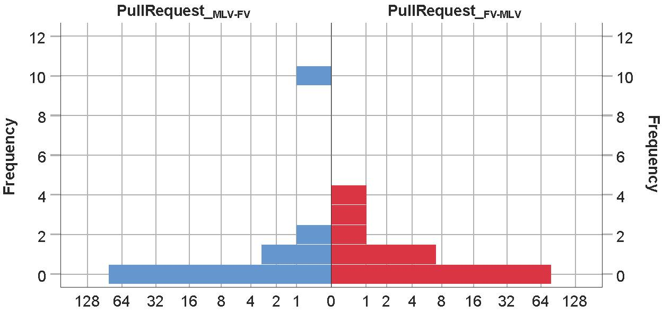

RQ2 - How are app families maintained? - Results
Number of pull requests
Pull requests (Mainline-Fork)
Pull requests (Fork-mainline)
(Apps)
(Apps)
Both distributions are left-skewed
Most apps do not perform pull requests in either direction
Fork-to-Mainline – 10 forks sent 16 pull requests
Mainline-to-Fork – 5 mainlines sent 15 pull requests
Surprisingly, we observed that all the 15 pull requests (mainline-to-fork) were initiated by fork developers
10

Slide 11
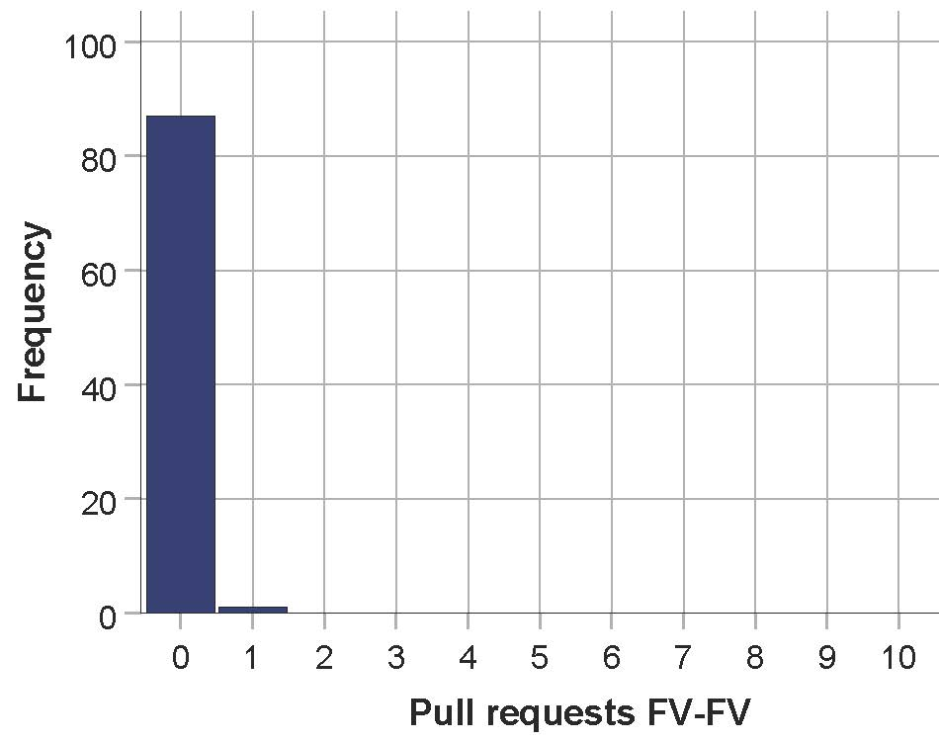
RQ2 - How are app families maintained? - Results
Number of pull requests among forks
(Apps)
Pull requests (Fork-Fork)
Distribution is left-skewed
Only one fork sent one pull request to another fork

Slide 12
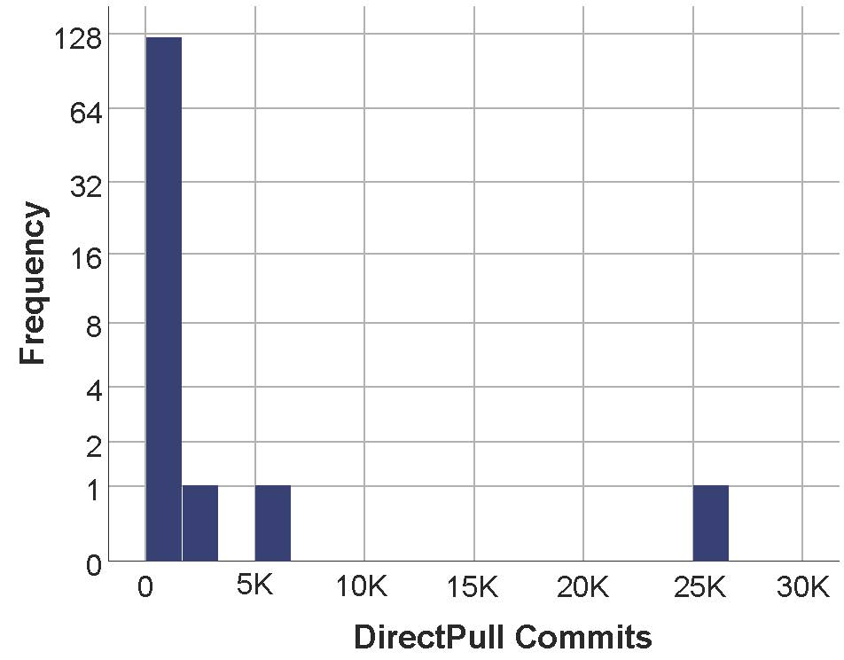
RQ2 - How are app families maintained? - Results
Number of direct pull commits from mainline to fork
(Apps)
Direct Pull Commits Mainline-Fork
Left-skewed distribution
47 of the 127 (37%) forks variants performed direct pull commits (cherry picked) form the mainline variants

Slide 13
RQ2 - How are app families maintained? - Summary
Variants rarely perform pull request code propagation
Direct pull commits is the most used code propagation method
64 of the 88 (72.7%) app families did not perform any form of code propagation

Slide 14
RQ3 - Diversity of contributors in app families?
We investigated whether the Fork variants are typically created and controlled by new developers
Or whether the forks are still governed by the mainline developers.

Slide 15
RQ3 - Diversity of contributors in app families?- Approach
Developer 1
Developer 2
Time
Mainline Variant
1
2
3
a
b
iii
c
d
f
i
c
d
e
f
Fork variant
i
i
ii
iii
c
1
2
3
iii
d
iv
f
Fork Date
Developer 1
Mainline variant commits: 1, 2, 3, a, b, c, d, e, and f
Fork variant commits: i, ii, iii, and iv
StartingCommits
PullRequestCom_{FV-MLV}
MLV UniqueCom
PullRequestCom_{MLV-FV}
DirectPullCom_{MLV-FV}
FV UniqueCom

Slide 16
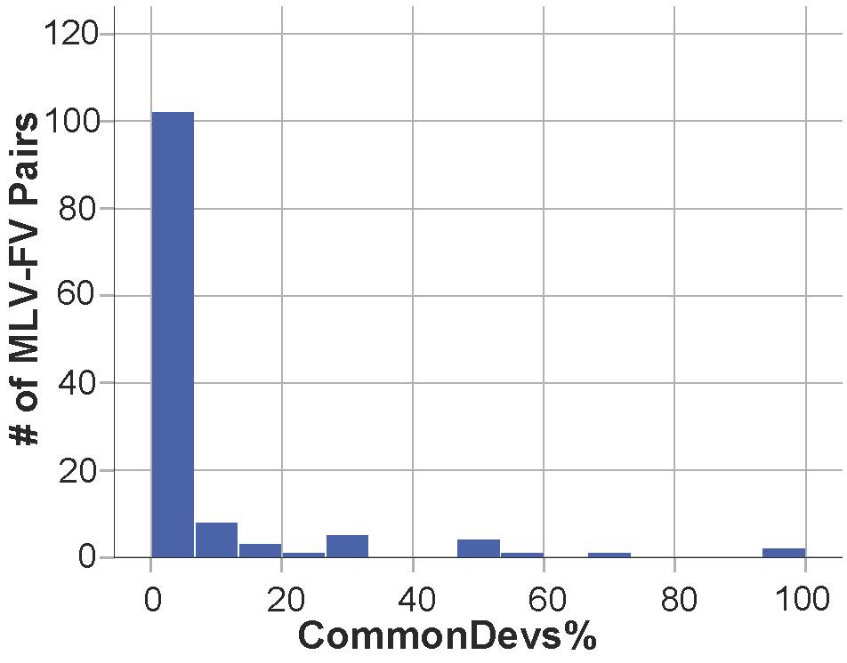
RQ3 - Diversity of contributors in app families? - Results
Common developers between Mainline-fork pairs
Left-skewed distribution
Most of the mainline-fork variant pairs have no common developers
94 of the 127 (74%) mainline-fork pairs do not have common developers
Mainline – Fork pairs

Slide 17
RQ4 - Various types of variations in app families
Why are variant forks created?
Does the fork variant (FV) add small functionality to the mainline variant (MLV) or,
Does the fork variant use the mainline as a building block for the apps completely different focus
Approach
Manual inspection of a sample of 11 of the 88 app families
Google Play
Features in App description
Github
Customizations and additions in the FV’s unique commits
FV
MLV

Slide 18
RQ4 - Various types of variations in app families - Results
We identified different types of reuse
Reuse Type 1: Fork variants performing re-branding and simple customizations of the mainline variant
Reuse Type 2: Fork variants implementing different but related features of the mainline variant
Reuse Type 3: Fork variants extending the mainline variant functionality
Reuse type 4: Fork variants supporting the mainline variant
Family members competing for clients/Users

Slide 19
RQ4 - Various types of variations in app families - Results
Reuse type 3 : Fork variants extending the mainline functionality
Example: Mainline has core functionality which the Fork Variants extend
Mainline variant - mendhak/gpslogger is a GPS tracker with basic functionality of logging the GPS coordinates on your SD card
Fork variant - dkm/gpslogger extends the mainline variant functionality with sophisticated GPS tracking by adding flight (paraglider) oriented features

Slide 20
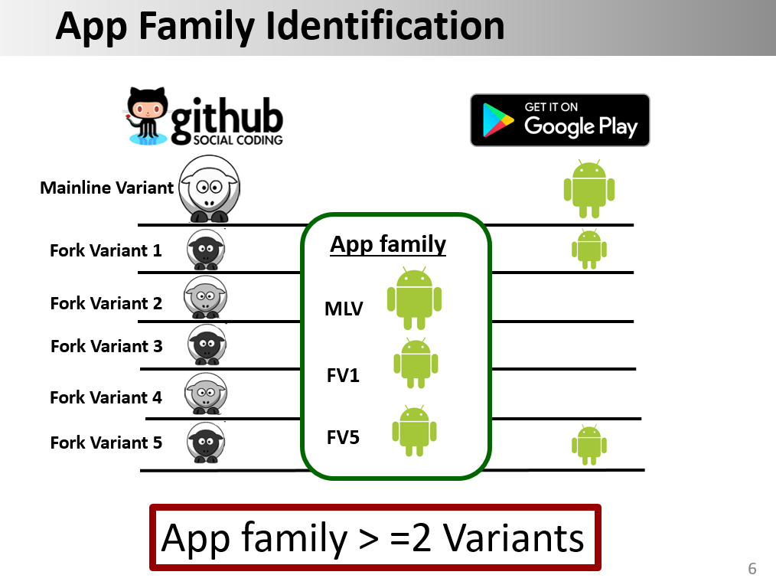
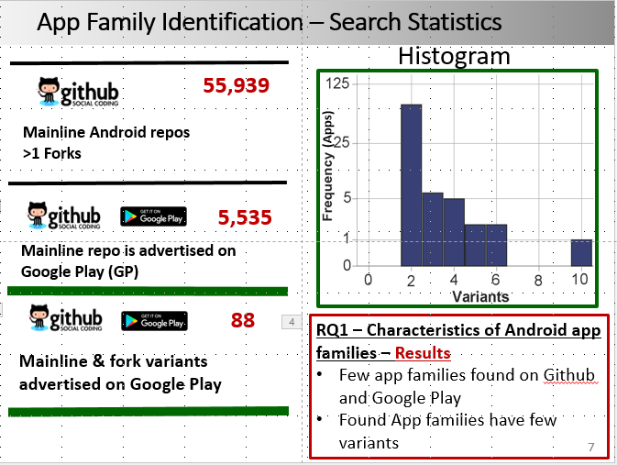
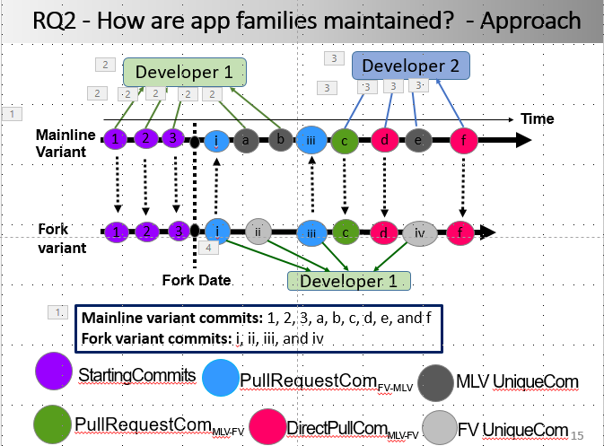
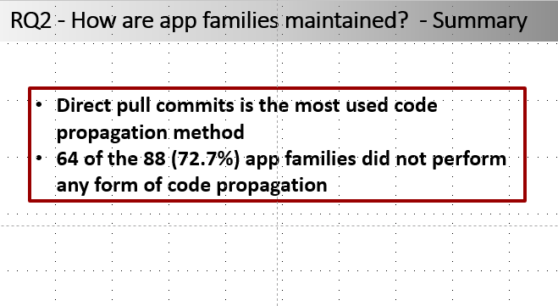
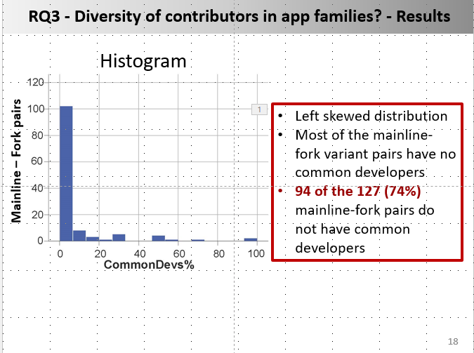
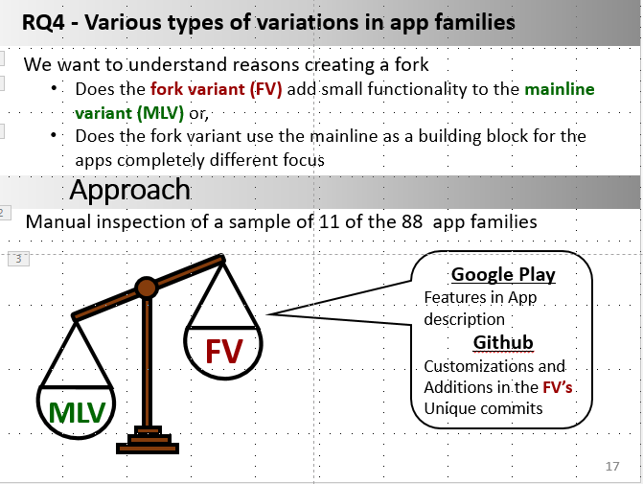
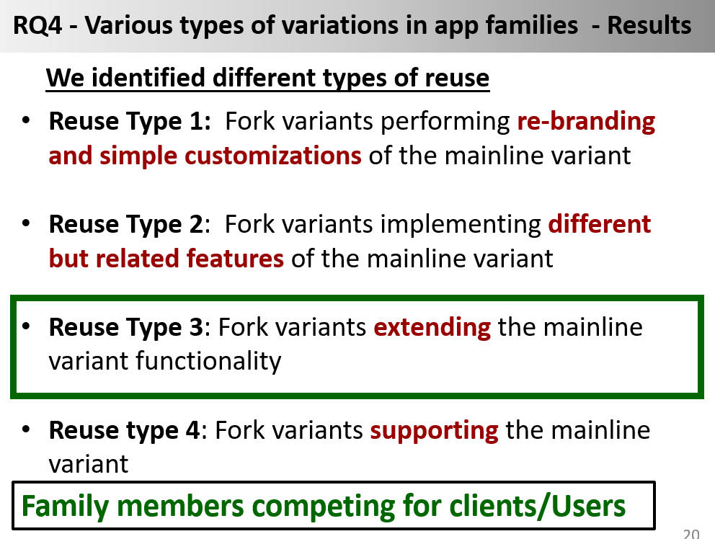
Clone-Based Variability Management in the Android Ecosystem
John Businge, Moses Openja, Sarah Nadi, Engineer Bainomugisha, Thorsten Berger
Contact: johnxu21@gmail.com

